Slide 1
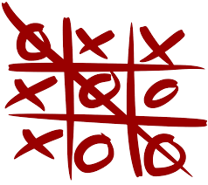

NAMES:- SAYED OMAR AABID(2100290110189) SHIV SHEKHAR(2100290110154)
SHIVAM YADAV (21002901156)

Slide 2
INTRODUCTION
TOOLSANDTECHNOLOGIES
STRATEGIES/ ALGO USED
FLOWCHART
SOURCE CODE
OUTPUT

Slide 3

Tic – tac –toe (also known as X’s and O’s) is a game for two players in which each player takes turn by marking the space in a 3x3 grid. The player who succeeds in placing three of their marks in a horizontal , vertical or diagonal row wins the game.

Slide 4
Language:- C
Online GDB Compiler
Logics used from C:- 1)If-else
2)Function calling 3)Loops

Slide 5
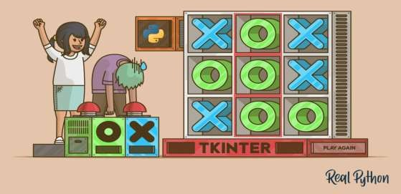
STRATEGY/ALGORITHM USED IN CODING
THE HIGHEST PRIORITY AND THE LOWEST PRIORITY RULES SEEMED TO BE OBVIOUS TO ME RIGHT AWAY.THE HIGHEST PRIORITY ARE THESE:
IF I CAN WIN ON THIS MOVE, DO IT.
IF THE OTHER PLAYER CAN WIN ON THE NEXT MOVE,BLOCK THAT
WINNING SQUARE.

Slide 6
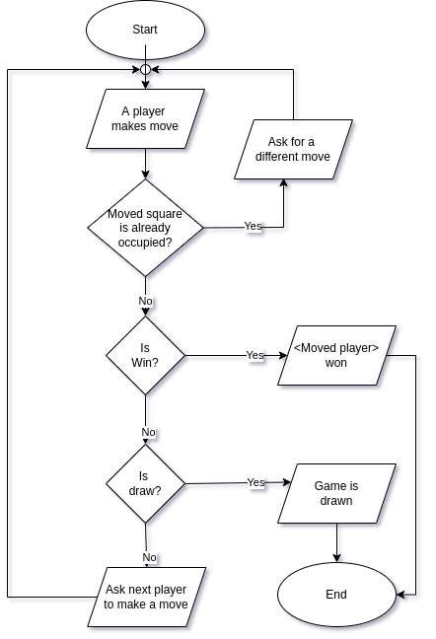
FLOWCHART

Slide 7
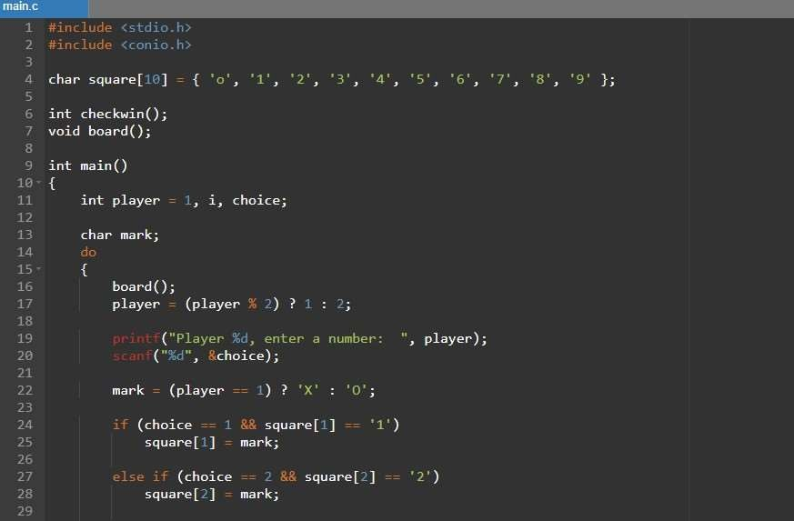
SOURCE CODE

Slide 8
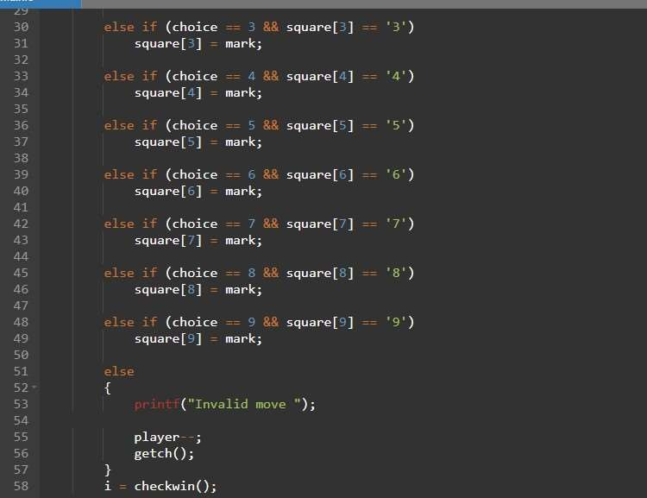

Slide 9
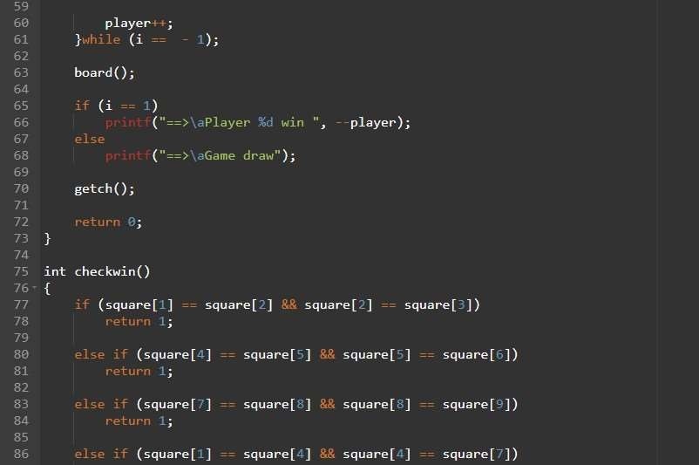

Slide 10
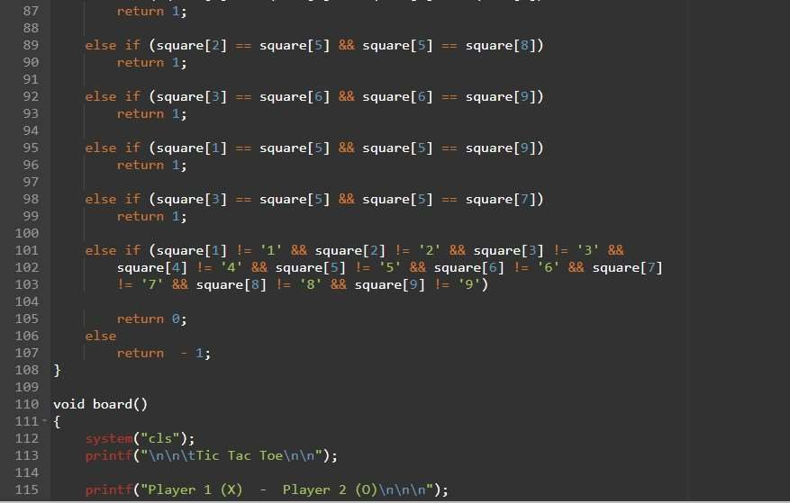

Slide 11
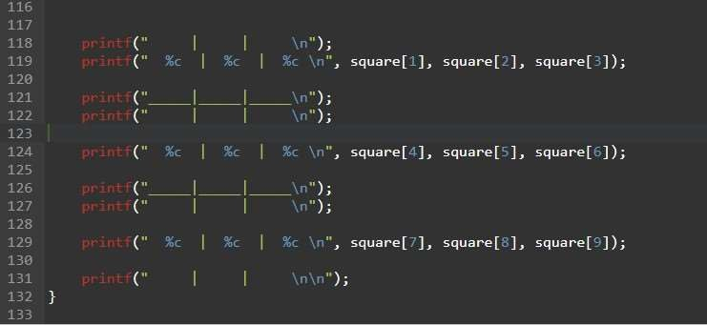

Slide 12
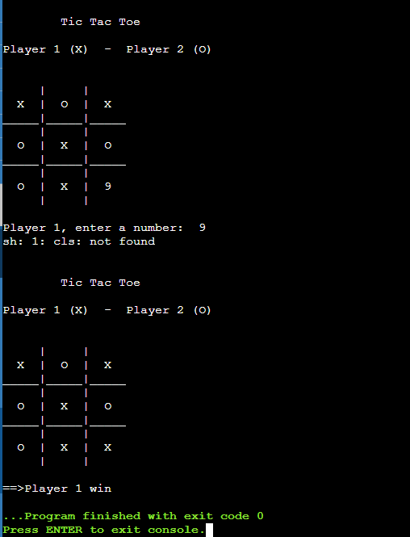
OUTPUT

Slide 13

